Slide 1
Cloud Native Software Engineering Property Management System Deployment on AWS
Team Number: 17
2300030570 – Rachapudi Sai Sree
2300030244 – Gurivi Reddy Yasaswini

Slide 2
The rapid growth of urban housing has created the need for efficient property management systems capable of handling large volumes of tenant and property data.
Traditional methods such as spreadsheets and manual documentation are prone to errors and inefficiencies
Problem Statement

Slide 3
. The Property Management System offers a centralized digital solution that simplifies property listing, tenant communication, and financial tracking. . The system enables landlords to manage multiple properties effectively while allowing tenants to search and rent properties conveniently. . Secure authentication mechanisms ensure data privacy and role-based access control. . This project demonstrates full-stack development skills while addressing real-world real estate challenges through modern web technologies.
Our Solution

Slide 4
Property Management System that simplifies property administration.
The system provides a landlord dashboard for managing listings using CRUD operations.
It allows tenants to search properties using filters such as price and location.
Another objective is to implement a reliable rent tracking mechanism that stores payment history and generates due reminders.
The project also focuses on role-based access control to ensure system security.
What our Application is about??

Slide 5
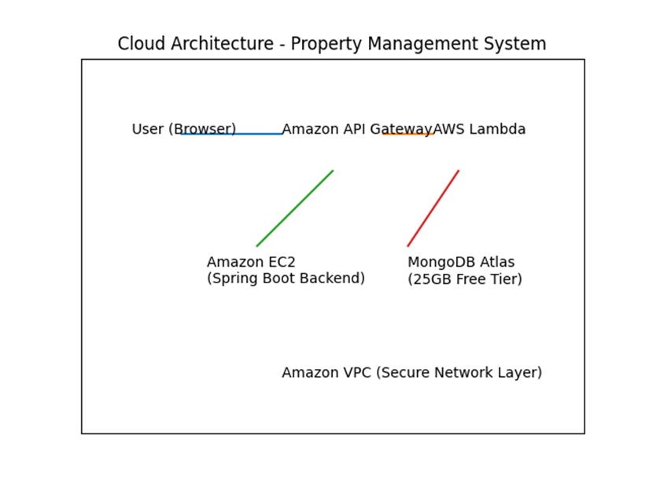
System Architecture

Slide 6
EC2.
VPC
Security Groups
Cloud Watch
Elastic Block Storage
Cloud Services we have used:

Slide 7
This is your main server
You used it to:
Launch Ubuntu instance
Install Docker & Docker Compose
Run your containers:
frontend (React + Tomcat)
backend (Spring Boot WAR)
MySQL
Public IP:13.206.122.248
EC2

Slide 8
A dedicated private cloud for our application
Used for:
Private network: 172.31.x.x
Subnet
Routing traffic
VPC

Slide 9
We have configured this when launching instance.
Used for:
Allowing ports:
22 → SSH
8082 → frontend
8083 → backend
3307 → MySQL
AWS Security Groups

Slide 10
This is our instance disk:
/dev/root 6.8GB
Used for:
OS (Ubuntu)
Docker images
Containers
Your project files
Amazon EBS (Storage)

Slide 11
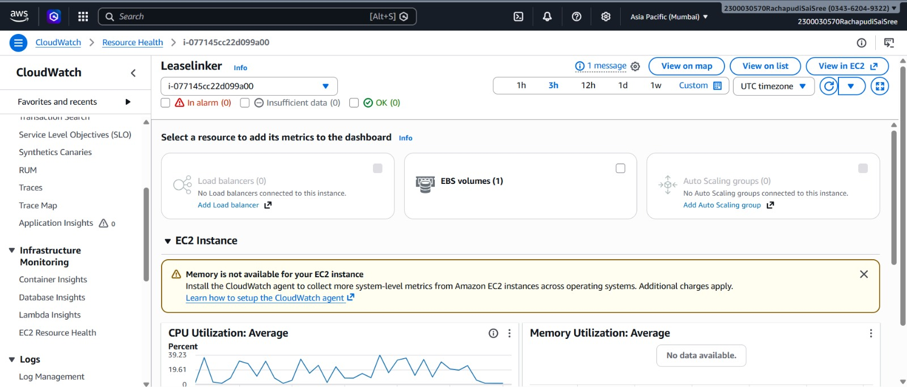
Basic Metrics:
CPU usage
Network in/out
Disk read/write
Status checks (instance health)
AWS Cloud Watch

Slide 12
1. Amazon Web Services Documentation – https://aws.amazon.com/documentation/
2. MongoDB Atlas Documentation – https://www.mongodb.com/docs/
3. Spring Boot Official Guide – https://spring.io/projects/spring-boot
4. React Official Documentation – https://react.dev/
REFERENCES

